Slide 1
Math 769: Statistical Learning

Slide 2
Logistic Regression
Shahrzad Jamshidi, PhD

Slide 3
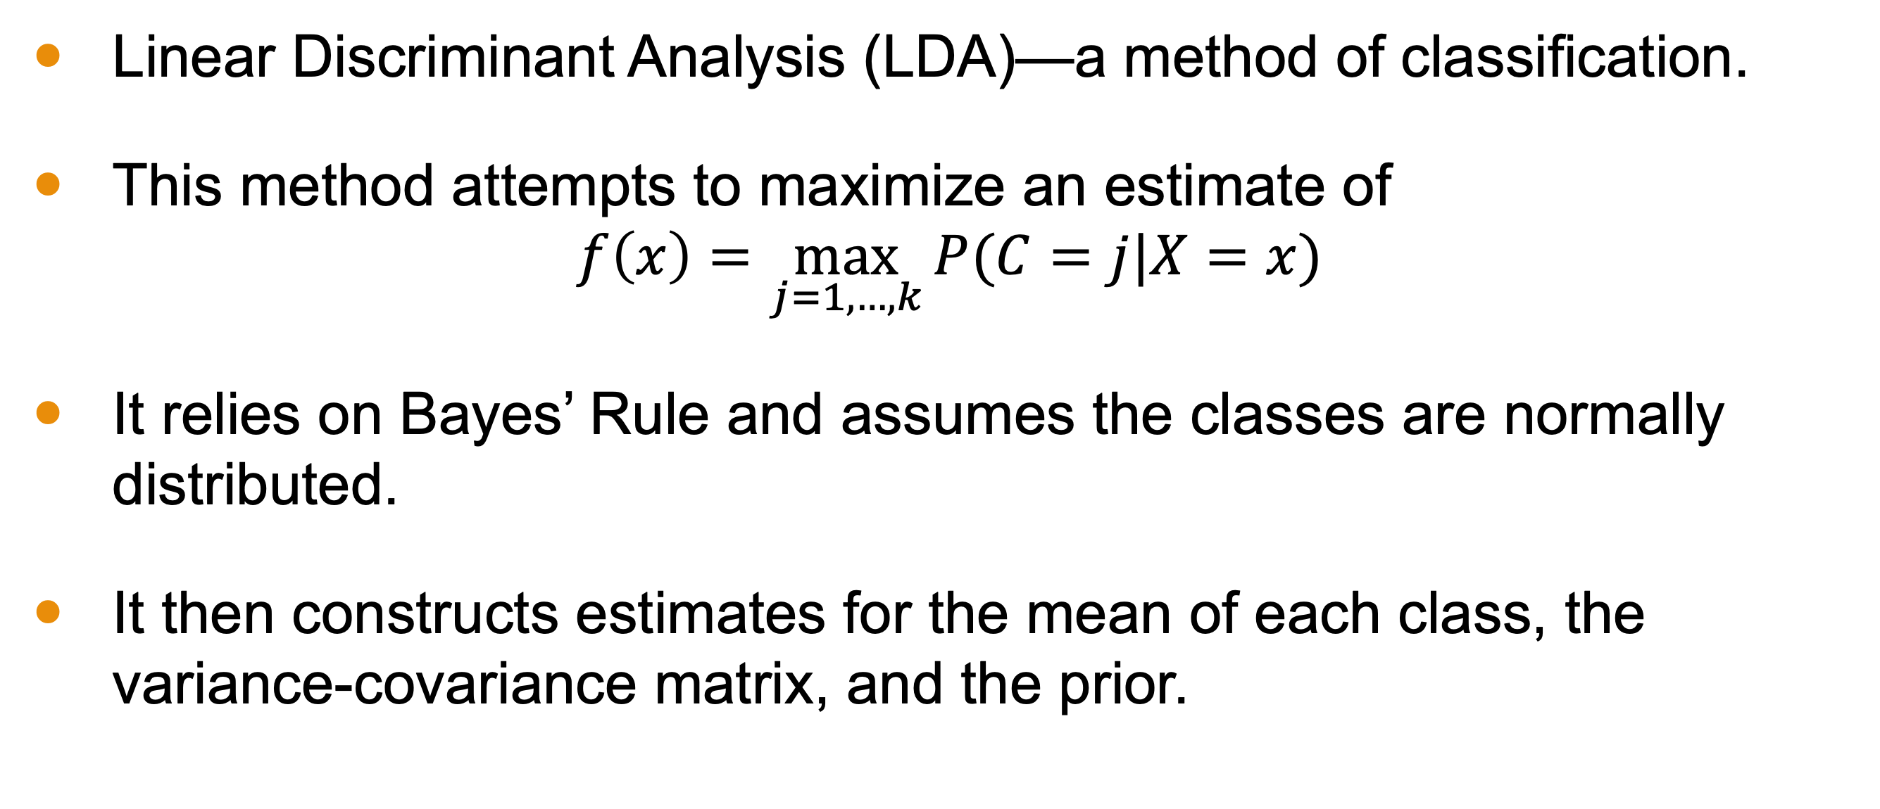
Last Lesson
Linear Discriminant Analysis (LDA)—a method of classification.
This method attempts to maximize an estimate of
$$f\left(x\right)=\max_{j=1, …, k}{P(C=j|X=x)}$$
It relies on Bayes’ Rule and assumes the classes are normally distributed.
It then constructs estimates for the mean of each class, the variance-covariance matrix, and the prior.

Slide 4
Objectives
Describe how logistic regression relates to LDA.
Explain how logistic regression maximizes likelihood.

Slide 5
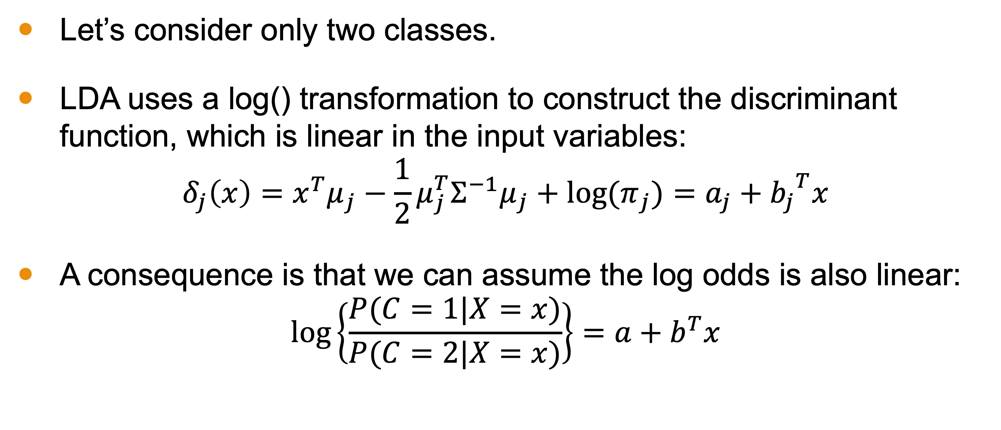
Consequence of LDA
Let’s consider only two classes.
LDA uses a log() transformation to construct the discriminant function, which is linear in the input variables:
$$δ_{j}\left(x\right)=x^{T}μ_{j}−\frac{1}{2}μ_{j}^{T}Σ^{−1}μ_{j}+\text{log}{(π}_{j})=a_{j}+{b_{j}}^{T}x$$
A consequence is that we can assume the log odds is also linear:
$$\text{log}\left\{\frac{P(C=1|X=x)}{P(C=2|X=x)}\right\}=a+b^{T}x$$

Slide 6
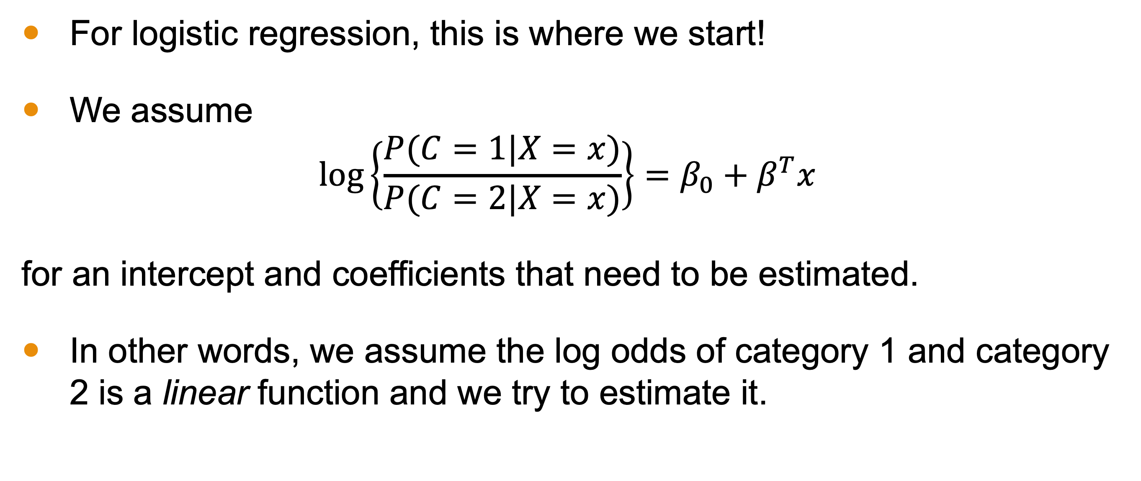
Logistic Regression
For logistic regression, this is where we start!
We assume
$$\text{log}\left\{\frac{P(C=1|X=x)}{P(C=2|X=x)}\right\}=β_{0}+β^{T}x$$
for an intercept and coefficients that need to be estimated.
In other words, we assume the log odds of category 1 and category 2 is a linear function and we try to estimate it.

Slide 7
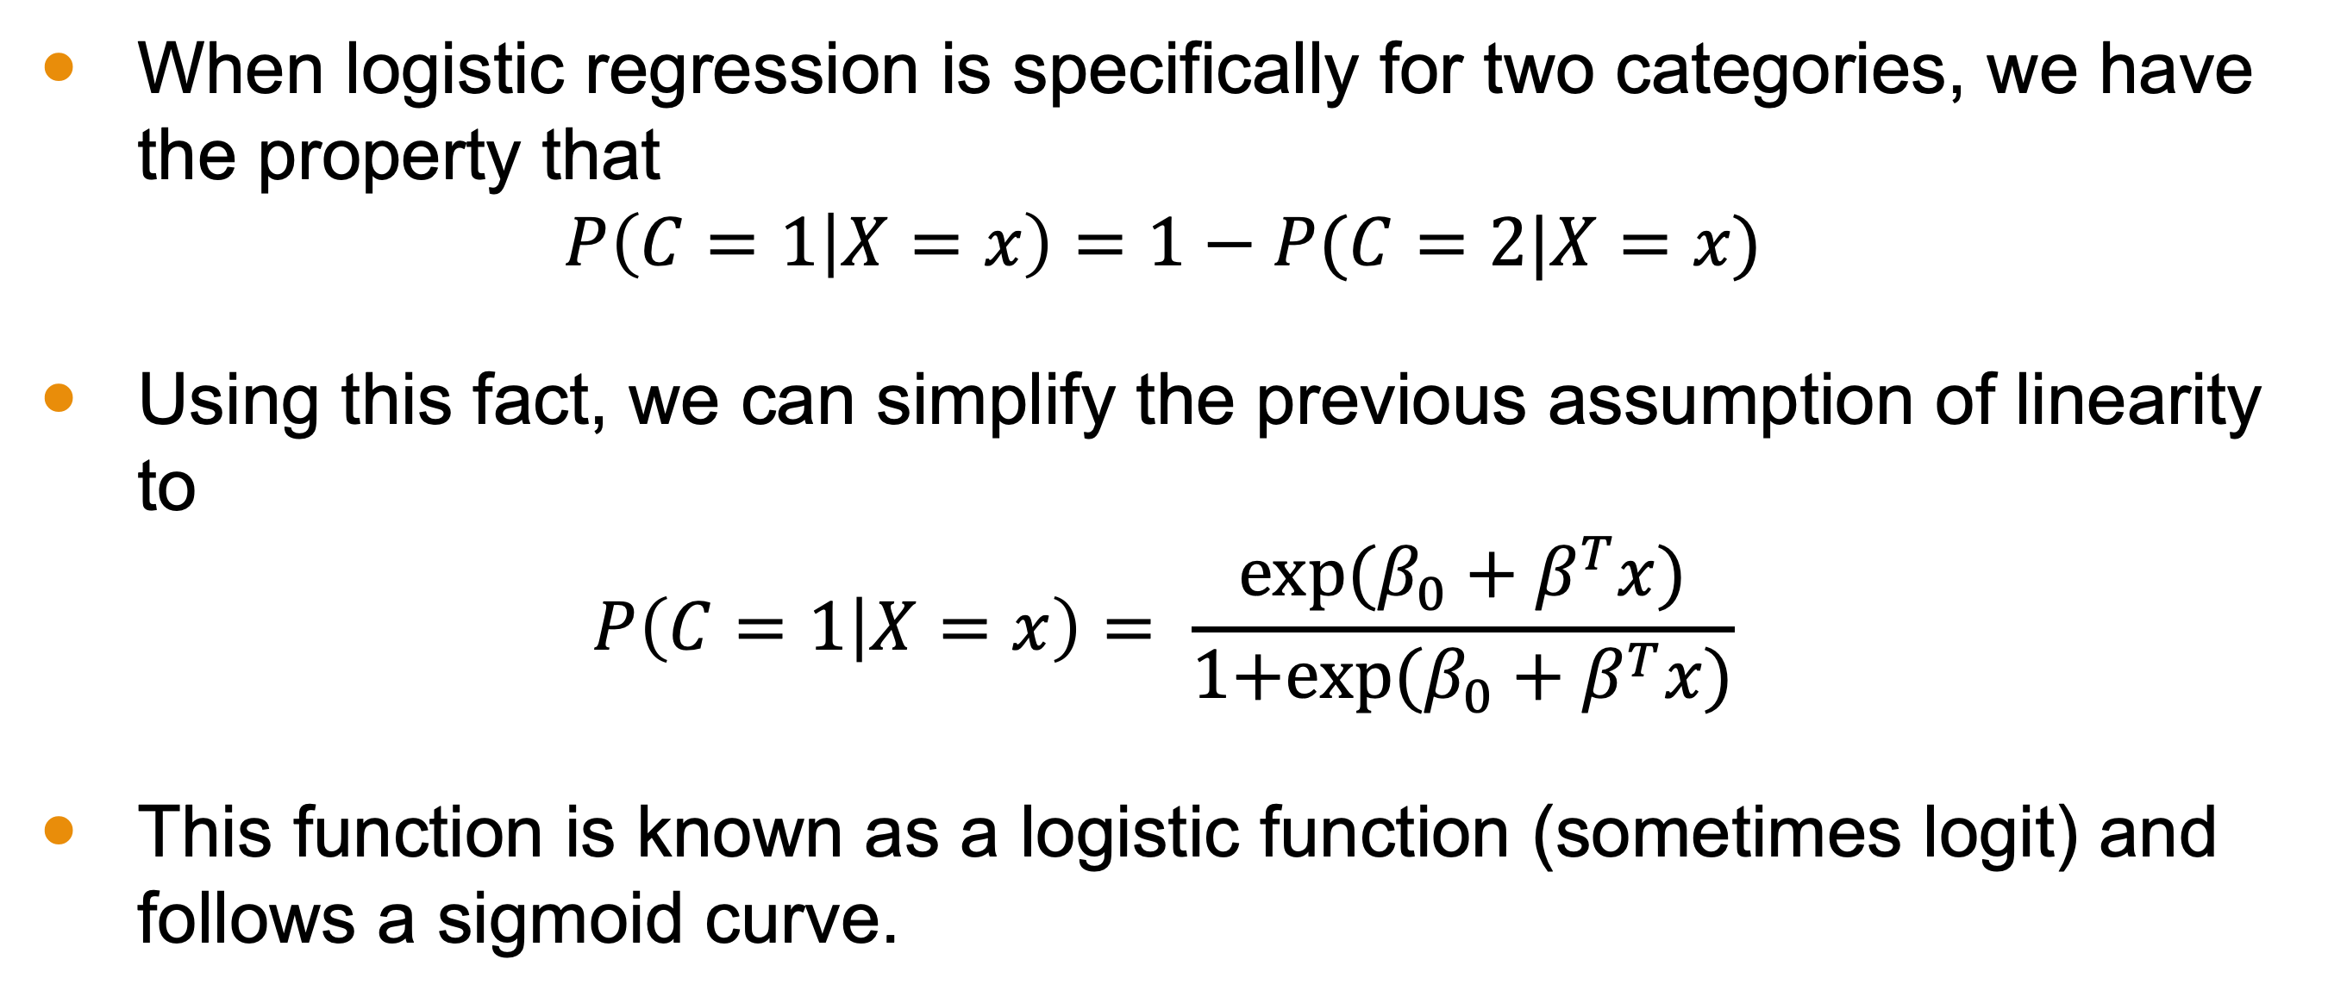
Two Categories
When logistic regression is specifically for two categories, we have the property that
$$P\left(C=1 | X=x\right)=1−P(C=2|X=x)$$
Using this fact, we can simplify the previous assumption of linearity to
$$P\left(C=1 | X=x\right)= \frac{\text{exp}\text{(}β_{0}+β^{T}x)}{\text{1+}\text{exp}\text{(}β_{0}+β^{T}x)}$$
This function is known as a logistic function (sometimes logit) and follows a sigmoid curve.

Slide 8
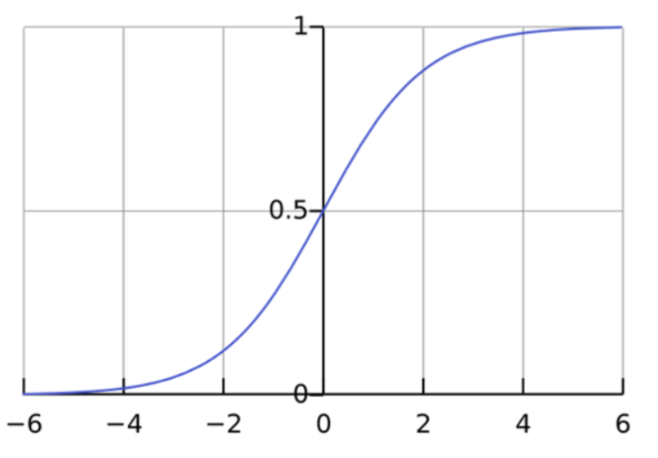
Logistic/Sigmoid Curve

Slide 9
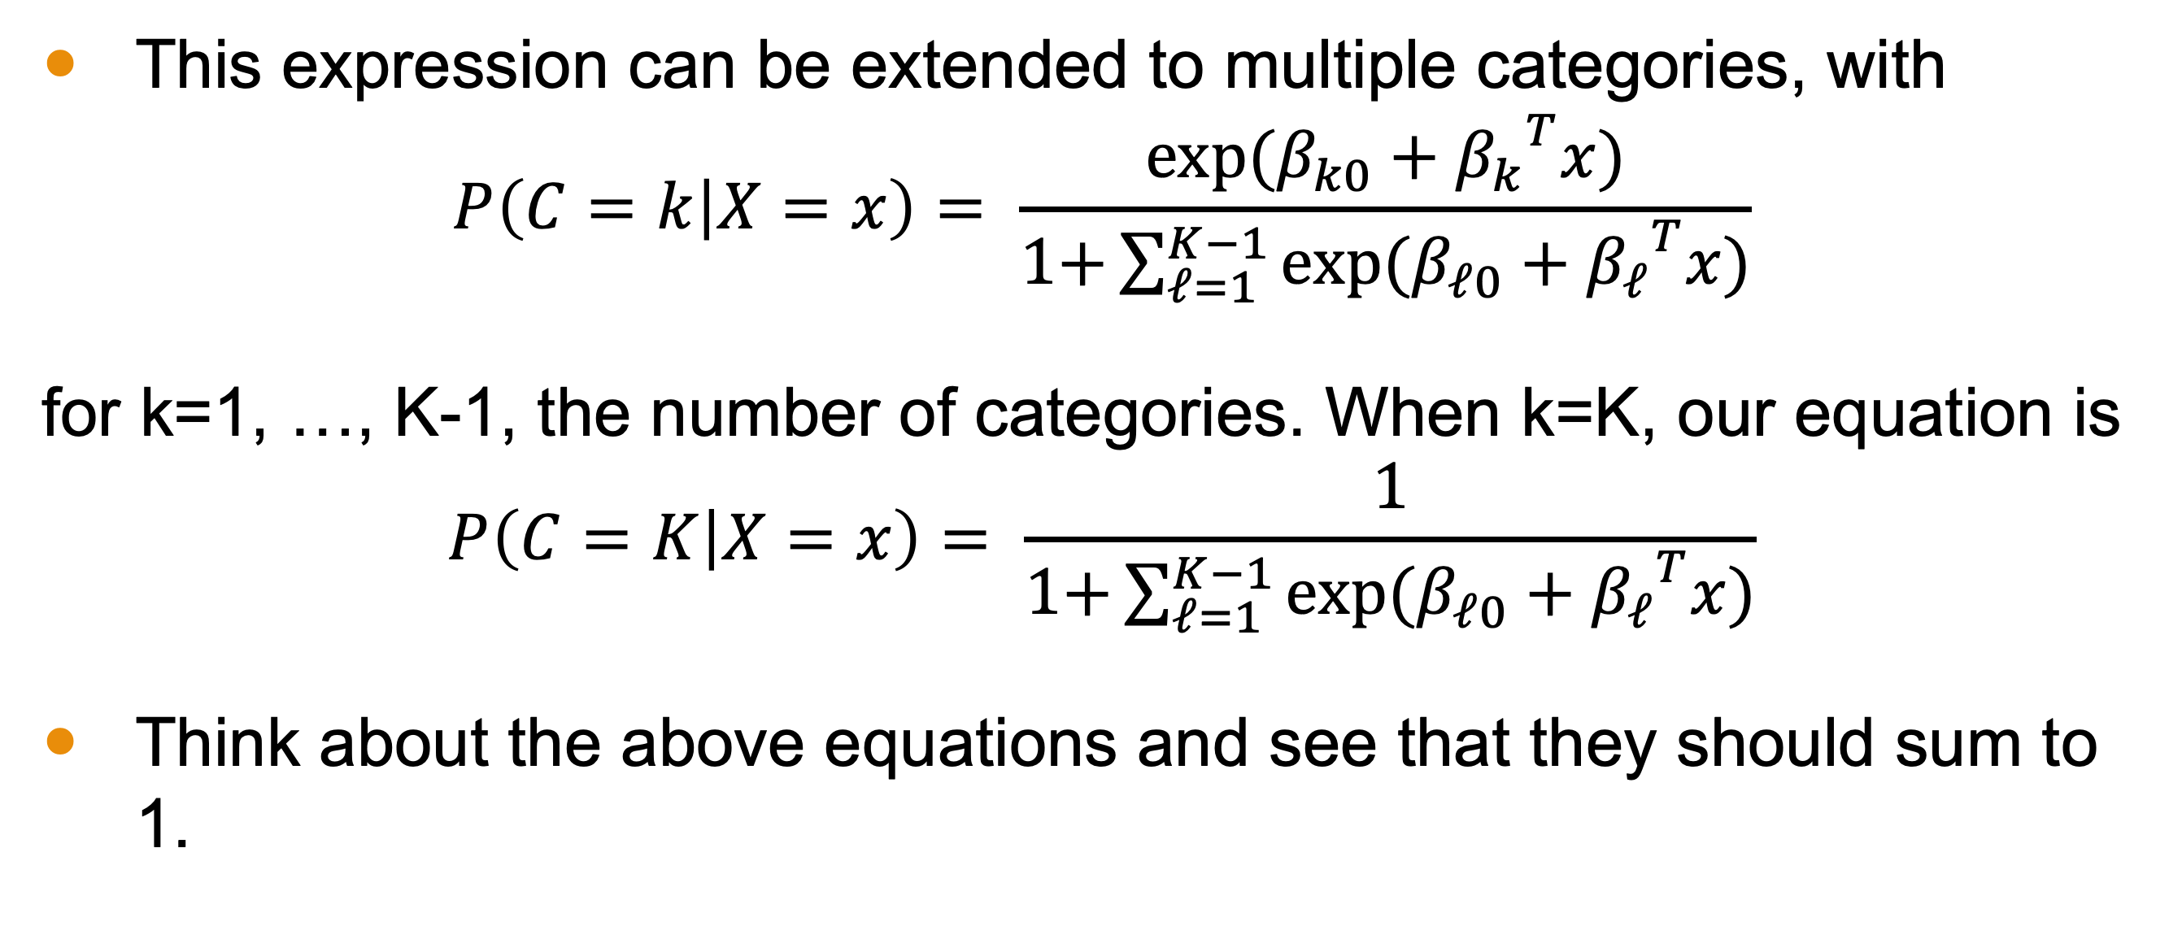
Multiple Categories
This expression can be extended to multiple categories, with
$$P\left(C=k | X=x\right)= \frac{\text{exp}\text{(}β_{k0}+{β_{k}}^{T}x)}{\text{1+}\sum_{ℓ=1}^{K−1}{\text{exp}\text{(}β_{ℓ0}+{β_{ℓ}}^{T}x)}}$$
for k=1, …, K-1, the number of categories. When k=K, our equation is
$$P\left(C=K | X=x\right)= \frac{1}{\text{1+}\sum_{ℓ=1}^{K−1}{\text{exp}\text{(}β_{ℓ0}+{β_{ℓ}}^{T}x)}}$$
Think about the above equations and see that they should sum to 1.

Slide 10
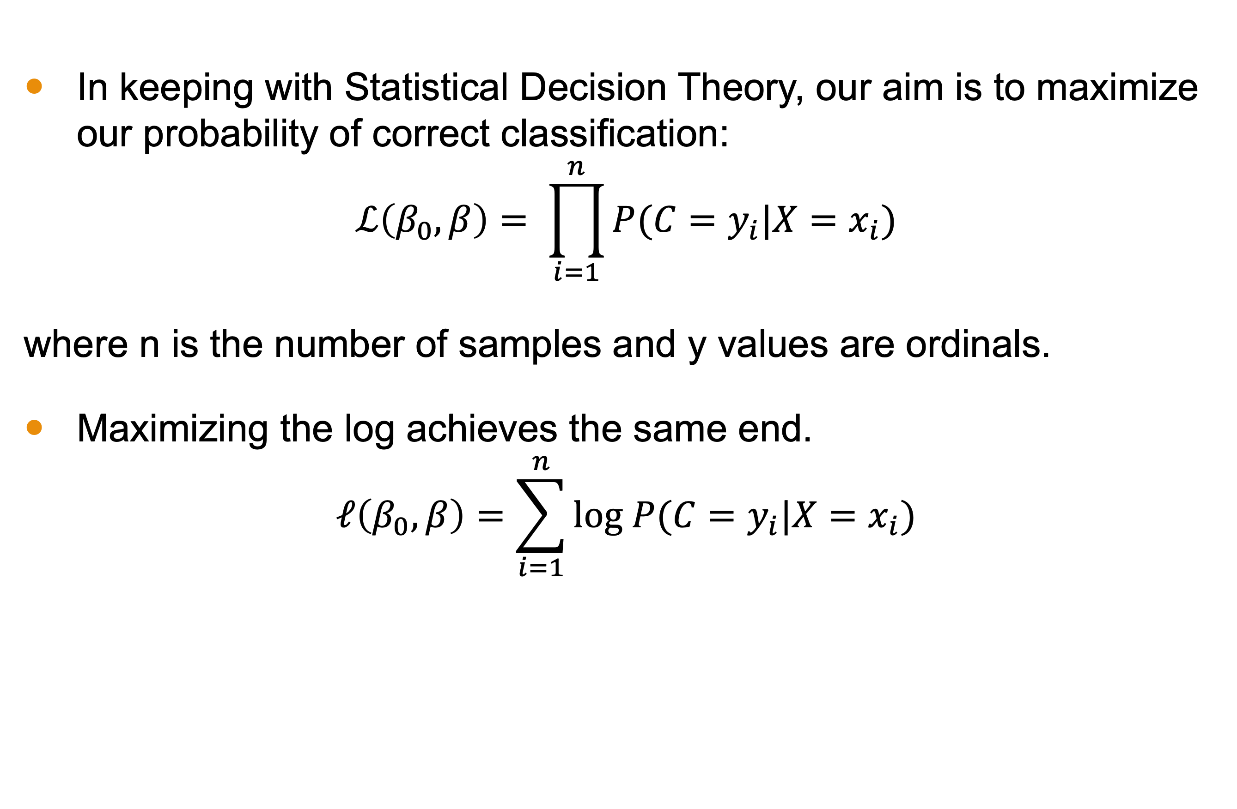
Maximizing Likelihood
In keeping with Statistical Decision Theory, our aim is to maximize our probability of correct classification:
$$ℒ\left(β_{0},β\right)= \prod_{i=1}^{n}{P(C=y_{i}|X=x_{i})}$$
where n is the number of samples and y values are ordinals.
Maximizing the log achieves the same end.
$$ℓ\left(β_{0},β\right)=\sum_{i=1}^{n}{\text{log} P(C=y_{i}|X=x_{i})}$$

Slide 11
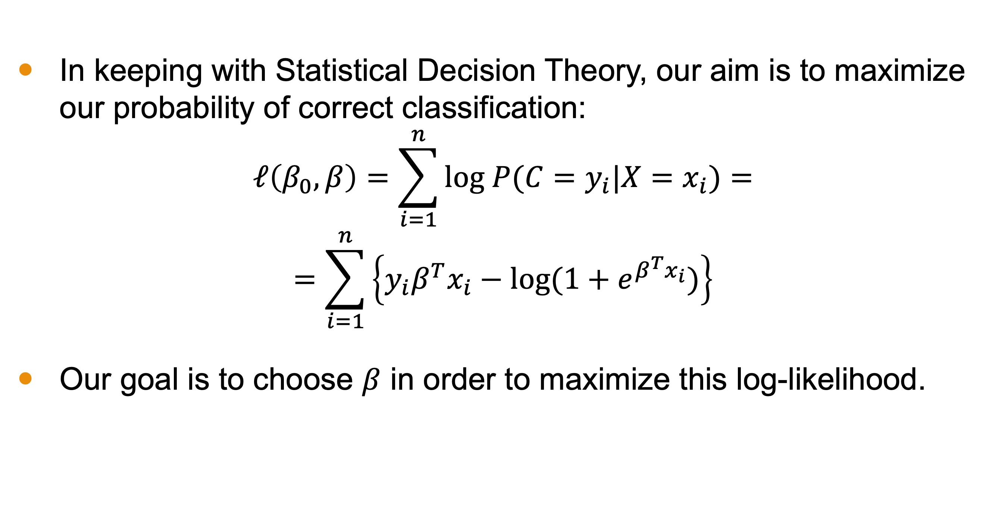
Maximizing Log-Likelihood
In keeping with Statistical Decision Theory, our aim is to maximize our probability of correct classification:
$$ℓ\left(β_{0},β\right)=\sum_{i=1}^{n}{\text{log} P(C=y_{i}|X=x_{i})}=$$
$$=\sum_{i=1}^{n}{\left\{y_{i}β^{T}x_{i}−\text{log}(1+e^{β^{T}x_{i}})\right\}}$$
Our goal is to choose $β$ in order to maximize this log-likelihood.

Slide 12
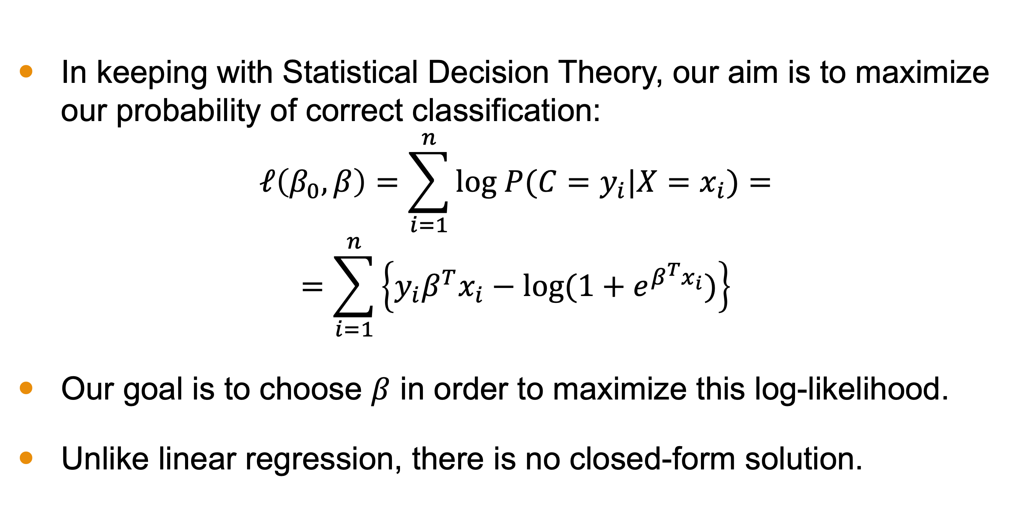
Maximizing Log-Likelihood
In keeping with Statistical Decision Theory, our aim is to maximize our probability of correct classification:
$$ℓ\left(β_{0},β\right)=\sum_{i=1}^{n}{\text{log} P(C=y_{i}|X=x_{i})}=$$
$$=\sum_{i=1}^{n}{\left\{y_{i}β^{T}x_{i}−\text{log}(1+e^{β^{T}x_{i}})\right\}}$$
Our goal is to choose $β$ in order to maximize this log-likelihood.
Unlike linear regression, there is no closed-form solution.

Slide 13
How do you maximize in general?
Notes:
This is where the linear algebra comes in

Slide 14
Maximizing Models in General
One way to maximize model parameters is with Calculus.
Find the derivative(s) with respect to the parameter(s).
Set the derivative to 0 and solve for critical values of the parameter(s).]
Check that the second derivative is negative to ensure the critical point is a maximum.

Slide 15
Solvers for Logistic Regression
Solvers for Logistic Regression use derivatives and Newton’s method to find the coefficients.
The textbook discusses this in detail on page 120.

Slide 16
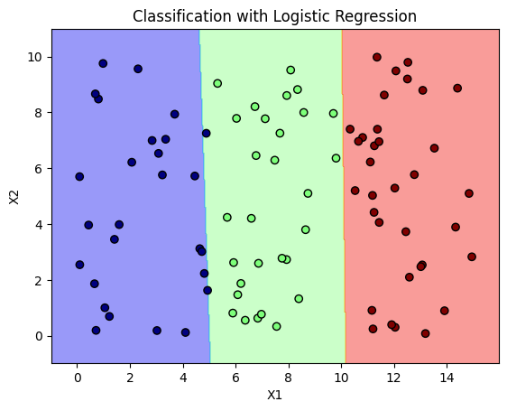
Example
Let’s revisit the political party example from Lesson 1.
Logistic Regression is very effective as a classifier.
Visually, this is better than linear regression

Slide 17
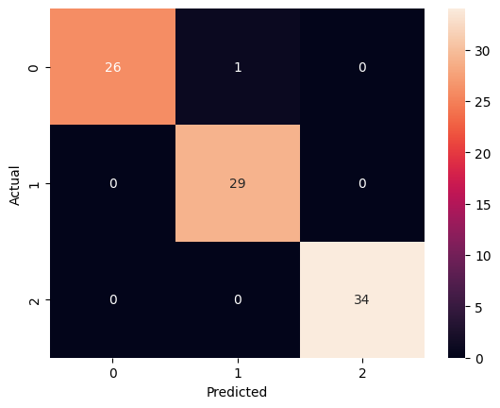
Example Metrics
The confusion matrix illustrates that all but 1 of the testing set were correctly classified.
Accuracy: 99%
Average Precision: 99%
Average Recall: 99%
So this is a very effective technique!

Slide 18
Conclusion
Logistic regression relies on assuming the log-odds are linear.
This is used to maximize the conditional probabilities, which take the form of a logistic curve.
The result is a function that smoothly categorizes values to 0 or 1 or something in between.

